Slide 1

Benford's Law and Zipf's Law: Finding Hidden Patterns in Data
AI Course Project
Team Members: Sandesh, Swarnim, Neha, Tisha

Slide 2

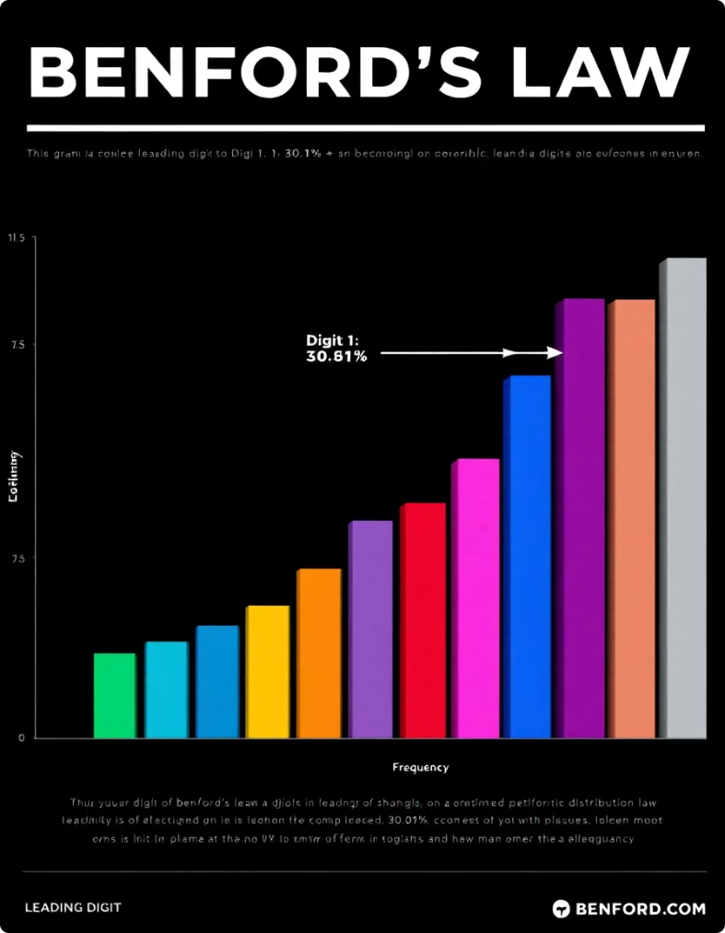
Introduction to Benford's Law
Definition
Distribution of leading digits in real-world numbers.
Expected Pattern
Digit 1 appears ~30%; digit 9 less than 5% of time.
Applications
Financial data, population stats, and more.
History
Identified by Newcomb (1881), rediscovered by Benford (1938).

Slide 3

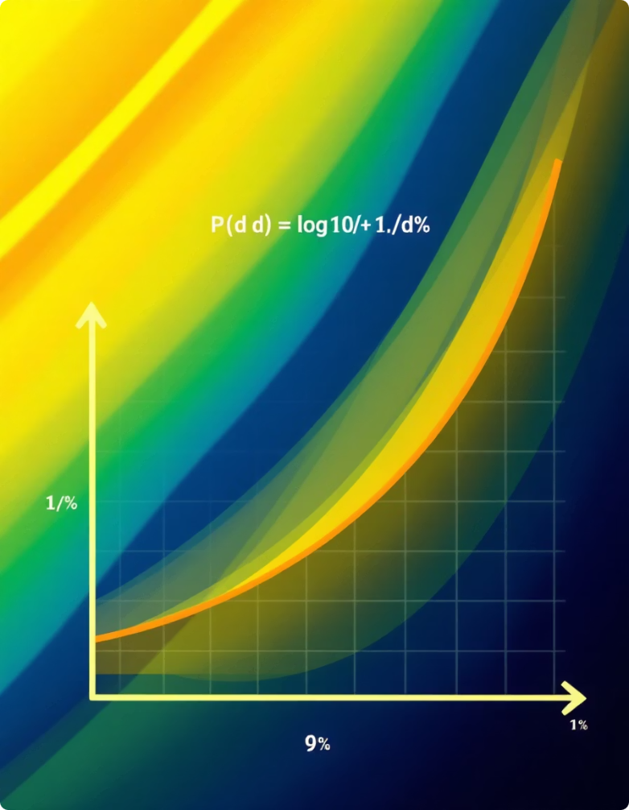
Mathematical Foundation of Benford's Law
Formula
P(d) = log10(1 + 1/d), with d the leading digit 1-9
Scale Invariance
Law applies regardless of the unit of measurement.
Base Invariance
Consistent behavior across different numeric bases.
Why It Works
Numbers favor smaller digits due to logarithmic scaling.

Slide 4

Dataset Selection and Preparation
Dataset
Data Cleaning
Preprocessing
Twitter data collected for analysis
Removed non-numeric data and handled missing values
Extracted leading digits for analysis

Slide 5
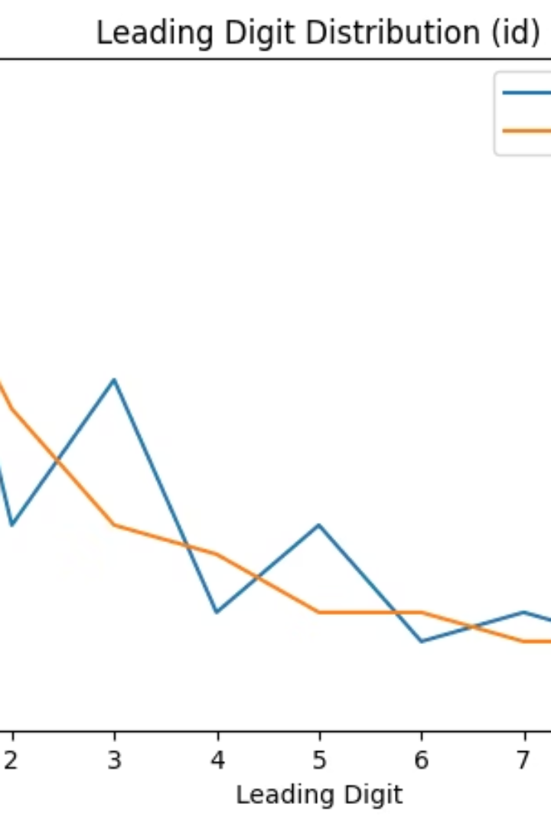
Analysis: Twitter Data
Findings
Deviation Metric
Leading digit distribution in Twitter data aligns well with Benford's Law.
Mean Absolute Deviation (MAD) = 0.028, indicating a strong fit.
Explanations
Reflects natural data gathering and user activity patterns on the platform.

Slide 6

Team Contributions
Sandesh
Created and developed the main notebook and generated all visualizations.
Swarnim
Main notebook data, presentation design and creation
Neha
Data preparation, analysis, writing
Tisha
Data cleaning, writing, report summarization

Slide 7
Thank You!

